Slide 1


NIE Institute Of Technology, Mysuru
Approved by AICTE, New Delhi | Affiliated to VTU, Belagavi
DEPARTMENT OF ELECTRICAL AND ELECTRONICS ENGINEERING
Presentation on
SMART HUMAN HEALTH MONITORING SYSTEM
PROJECT GUIDE :
Mr. Bhushith M.K
ASST. PROFESSOR
DEPARTMENT OF EEE
TEAM MEMBERS :
Miss. Divya K R - (4NN18EE406)
Miss. Pooja K - (4NN18EE417) Miss. Ruchitha K T - (4NN18EE421)

Slide 2
CONTENT
Introduction
Methodology
Design

Slide 3
INTRODUCTION
Now a day’s technology is running with time, it completely occupied the life style of human beings. It is being used everywhere in our daily life to fulfil our requirements.
In the recent development of internet of things(IoT) makes all objects interconnected and been recognized as the next technical revolution. Patient monitoring is one of the IoT application to monitor the patient health status. Using IoT doctor can continuously monitor the patient’s on his smart phone and also the patient history will be stored on the web server and doctor can access the information whenever needed from anywhere.
Our project named “SMART HUMAN HEALTH MONITORING SYSTEM”. In this project we are making use of technology to sense serious health problems so that efficient medical services can be provided to the patient in appropriate time.

Slide 4
Health monitoring system which monitors the physiological parameters of the patient which includes Body temperature, Heartbeat, Blood pressure.
This project aims in sending alert messages in emergency times, then alerting messages will be send to the mobile phone, the message consist of location of that person also. Here we get the alerting message from the GSM modem (SMS Message) and the location of that person can be found out with the help of GPS. So that the doctor can locate him/her and reach in time to save the life.

Slide 5
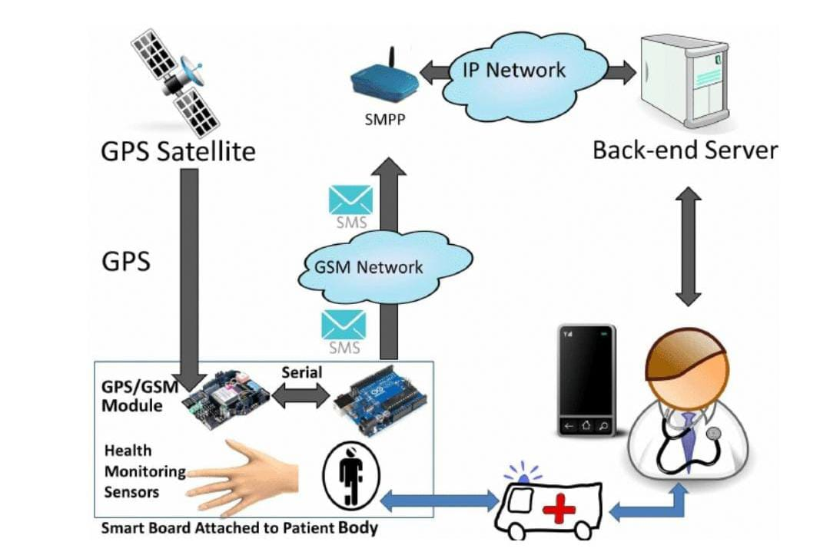
METHODOLOGY

Slide 6
Doctors are provided with a simple web-based application to track and monitoring the patient’s health conditions. The implemented web application is accessible through a standard web browser, smart phone and tablets devices.
The REST (RESTful) software architectural style has been adapted to insure the resulted web application is scalable and flexible.
The front-end represents the web-page which is accessible by the Doctors and Nurses. This part uses several web technologies such as HTML5, CSS the open source JQuery software library and Javascript client side programming language.
The middle tire which hosts the main server logic has been developed using PHP programming language and this logic has been deployed on an Apache web server.
System Hardware Model RESTful style to expose its internal functionality towards the client side web-page as well as this software tire leverage on the MySQL native driver for PHP in order to store and retrieve data.
The back-end tire which hosts the MySQL database server and this database is used to store all the patient data, system users, patients medical profiles and their corresponding alerts.

Slide 7
DESIGN
Regulated power supply
Microcontroller
IoT
Blood pressure
GPS
Heartbeat
GSM
Body temperature
LED Indicator

Slide 8
This section provides insights structure of the proposed system and explains the main building blocks and the interconnection relation-ships among the system blocks.
Mainly, the proposed system aims to cover an end-to-end smart health application that can be build up from two functional building blocks.
The ﬁrst block function is to gather all sensory data that are related to the monitored persons.
The second block functions are to stores the data, process and present the resulted information to the doctors and nursery staff.
When the patient’s heartbeat rate changes badly, the Arduino which recorded Pulse and Temperature Sensors readings, orders GSM shield to send an SMS message containing these readings, patient ID and the location of the patient which has been taken via GPS shield, to his doctor’s mobile phone.

Slide 9
THANK YOU

